Slide 1
JSL Rochester
Data Analysis
Capstone for BANA 2025

Slide 2
RIT SCB
Contents
Capstone for BANA 2025
Introduction
Questions to Ask
Data Analysis
Models Used
Core Takeaways
Future Analysis

Slide 3

RIT SCB
Jewish Home Campus, Rochester, NY
Capstone for BANA 2025
About Jewish Senior Life (JSL), Rochester
Over 100 years dedicated to senior adult care.
The only Continuing Care Retirement Community (CCRC) in Rochester.
Offers a full continuum of care: independent living, assisted living, skilled nursing, and community-based services.
Serves both on-campus residents and community-based clients.
Employs nearly 1,000 staff members, reflecting its operational scale and reach.
Recognized by U.S. News & World Report for “Best Independent Living 2025”.

Slide 4
Project with questions to ask
Capstone for BANA 2025
Background: Collaboration between RIT SCB Capstone team and Jewish Home.
Objectives: apply predictive analytics to enhance care planning for JSL clients.Identify high risk clients for functional decline and provide actionable insights for care teams.
Questions to ask:
Which features impact the intervention needs in the coming month the most, and how can this guide resource allocation?
Which clients are most likely to experience significant fluid intake changes next month, and what preventive actions can reduce the risk of dehydration?
Which clients are predicted to significantly decline or improve in ADL_eating ability, and what targeted support can prevent deterioration or sustain improvements?

Slide 5
RIT SCB
Project roadmap
Goal
Step 1
Step 2
Step 3
Step 4
Capstone for BANA 2025
Receiving data from JSL
Analysing and cleaning data
Feature engineering
Transforming activity & demographic data into model-ready features
Modeling
One baseline model and ADL/Fluid intake changes with enhanced models
Insights & Next steps

Slide 6
RIT SCB
Data provided about patients from JSL Rochester
Capstone for BANA 2025
Information included
Interventions
Client information
Client demographics

Slide 7
RIT SCB
Problems to Probe
Questions to Ask
How we’ll respond
What information can we get from current patients to assist them best?
Identify demographic and medical variables relevant to client health, address missing or problematic data, and perform Exploratory Data Analysis (EDA)
1
How can we prevent or identify client interventions?
Perform Feature Engineering on patient medical data to create variables that might predict when intervention will occur
2
Are there any interesting trends in the patient data?
Analyze the relationships between our client intervention variables and form hypotheses that explain why they might exist.
3
Capstone for BANA 2025

Slide 8
RIT SCB
Data Cleaning
1
2
3
4
Converted Dates
Dropping Null Values
String Cleaning
Unknown Values
Capstone for BANA 2025
The data provided was pretty good but needed some adjusting.
The dates needed to be standardised - they were converted so we could use them for additional testing.
One of the approaches with missing data is to either fill with averages or to drop. Given the size of the data, it felt reasonable to drop empty values in order to ensure integrity in our result.
Some columns needed their tasks standardised, so we did so by stripping capitals in order to make everything uniform.
For the demographic data specifically, the unknown values were filled with unknown in order to use the remainder of the data. In this case, it made sense to keep this information as opposed to dropping it.

Slide 9
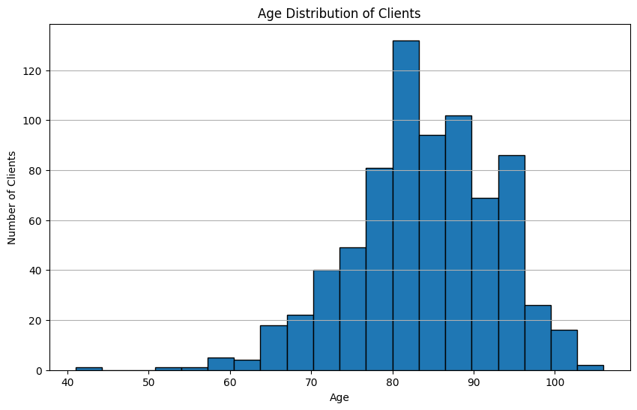
RIT SCB
Data Visualisation
Age Distribution
Capstone for BANA 2025
Some interesting information about age distribution can be seen with this plot.
Notably - there are some outliers at age 41, but a wide range serviced.
Oldest Patient - 106
Average Age - 84
Middle 50%: 78 - 90
Most of the clients fall between ages 78 and 90!

Slide 10
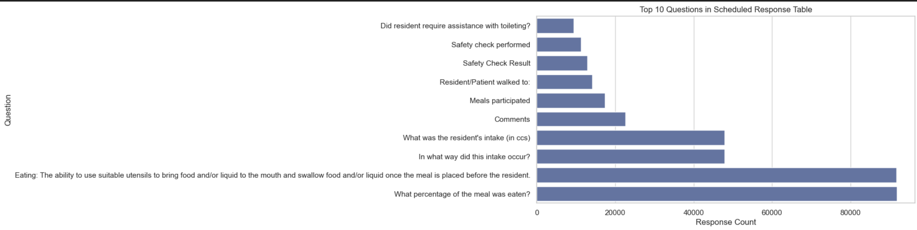
RIT SCB
Top 10 Questions
Capstone for BANA 2025
Most frequently recorded items relate to resident eating behavior:
“What percentage of the meal was eaten?” and “Eating: ability to use utensils & swallow food/liquid” dominate with over 90k responses each.
Moderate frequency for:
“What was the resident's intake (in ccs)?” (~45k), “In what way did this intake occur?” (~45k) & Lower counts for mobility, safety, and toileting checks.
Insight: Data collection heavily emphasizes meal-related intake, suggesting nutrition tracking is a central operational focus.

Slide 11
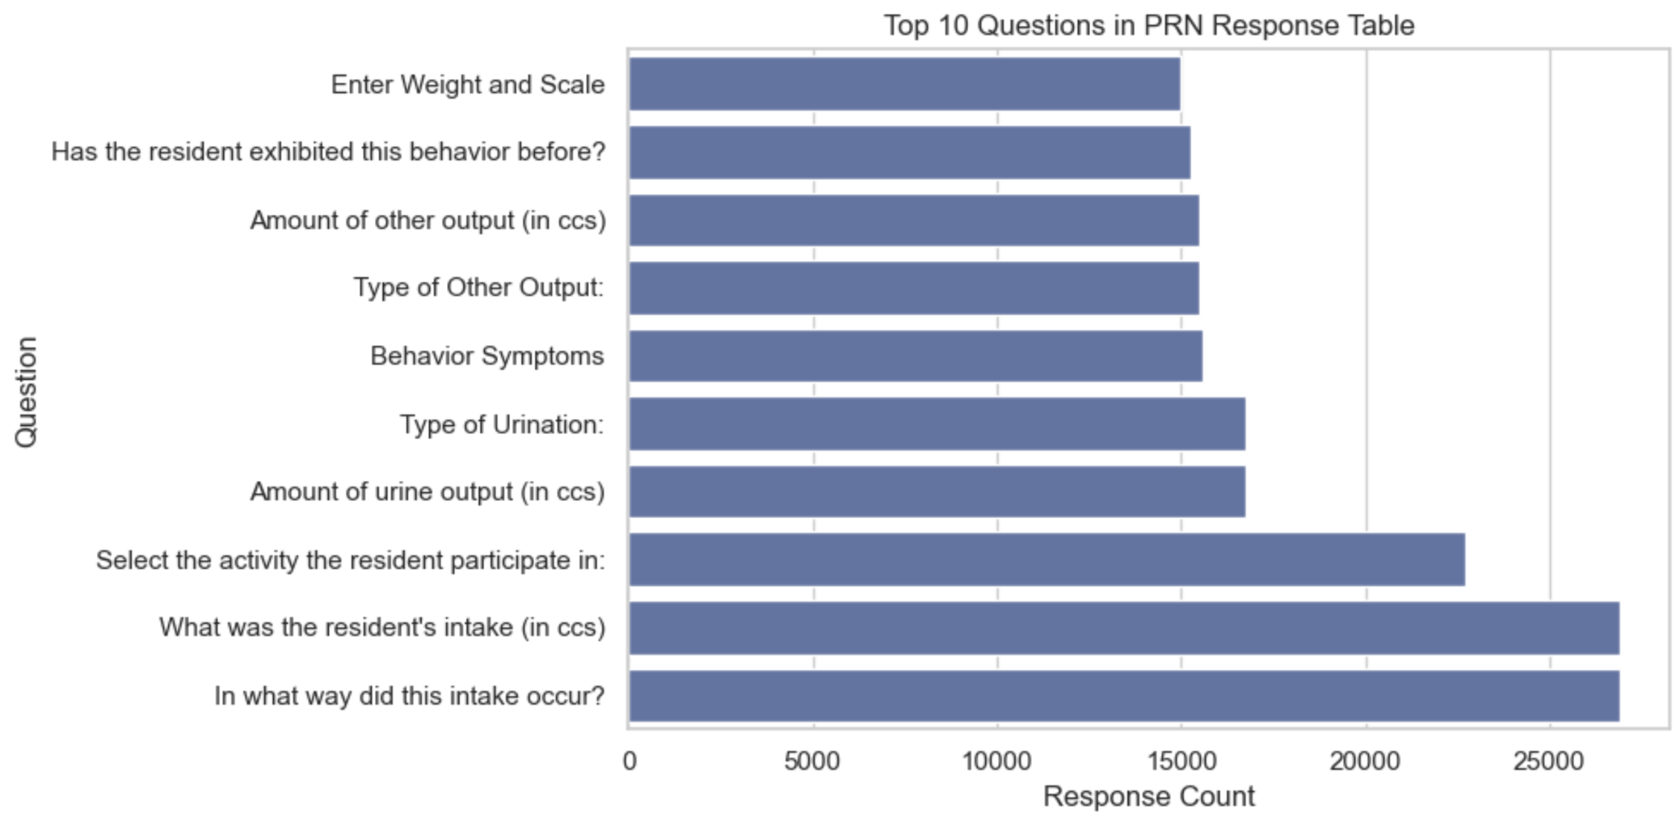
RIT SCB
PRN Response
Capstone for BANA 2025
Meal intake questions again lead:
“What was the resident's intake (in ccs)?” and “In what way did this intake occur?” (~27k responses each)
Other common categories:
Urine & other outputs (type and volume)
Behavior tracking (Behavior Symptoms, Has resident exhibited this behavior before?)
Weight and scale entries
.
Insight: PRN (as-needed) entries still prioritize intake/output but also capture episodic events like behavior changes

Slide 12
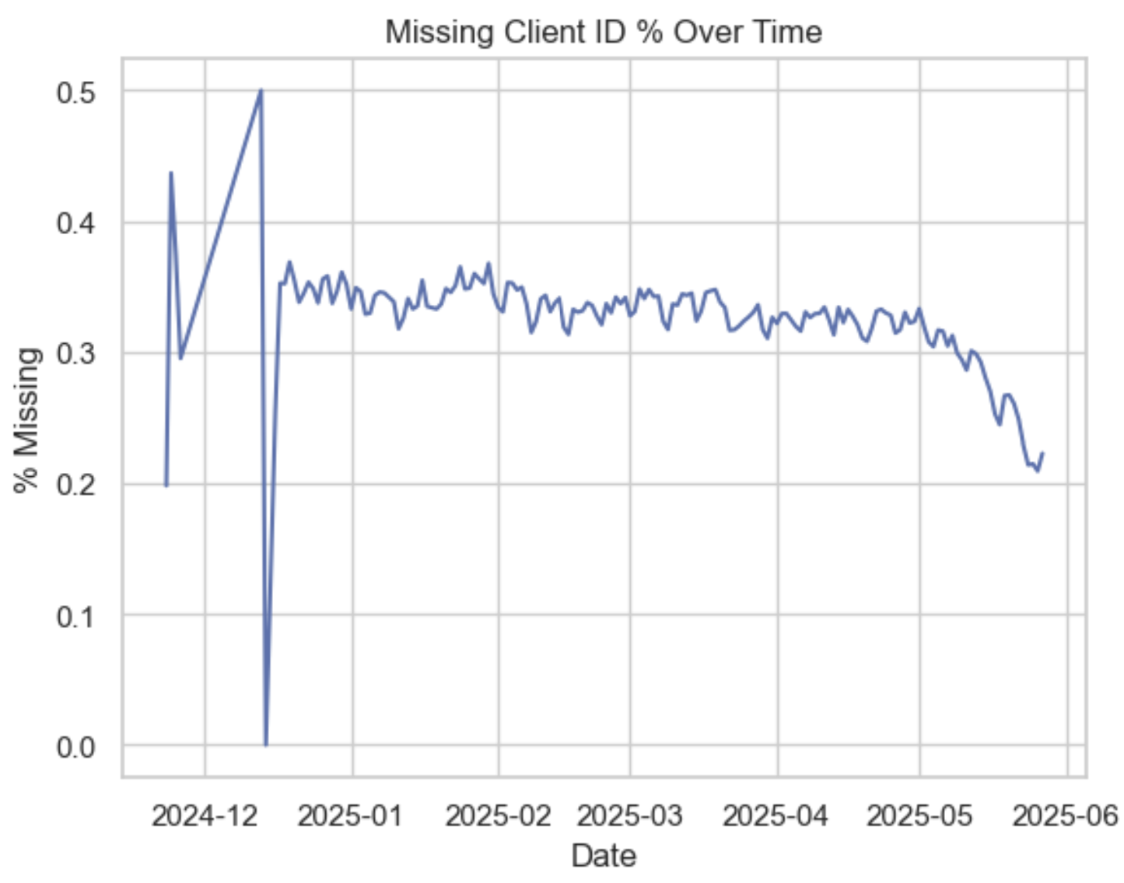
RIT SCB
Missing Client ID
Capstone for BANA 2025
Early fluctuations (Nov–Dec 2024) with spikes up to 50% missing.
Stabilized around 30–35% missing through early 2025.
Notable improvement from May 2025 onward, dropping near 20%.
Insight: Missing ID rates are decreasing, but persistent gaps suggest the need for data entry process improvements.

Slide 13
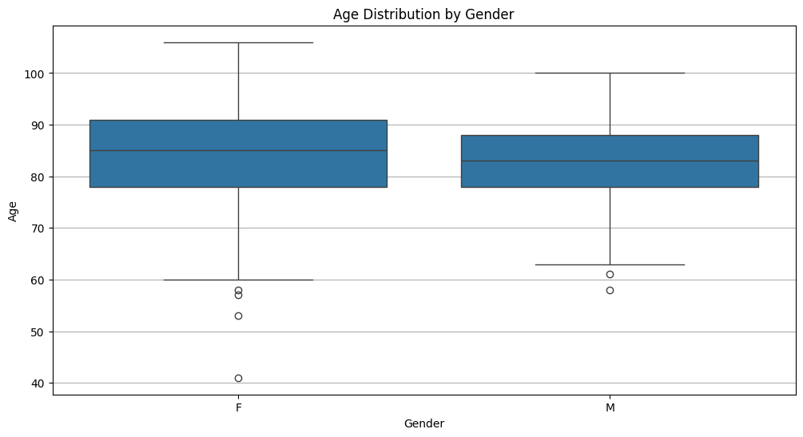
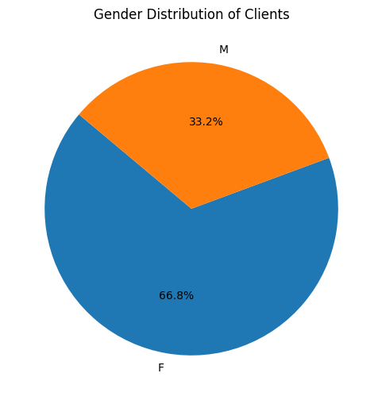
RIT SCB
Age Distribution
Age Distribution by Gender
Data Visualisation
Age range for Females is wider, with more outliers. Additionally, our age 41 patient is female.
Male patients see a smaller spread of central tendency - with fewer outliers.
Female Patients : 500
Male Patients : 249
There are 2x more female patients than male - and they cover a wider spread of ages.

Slide 14
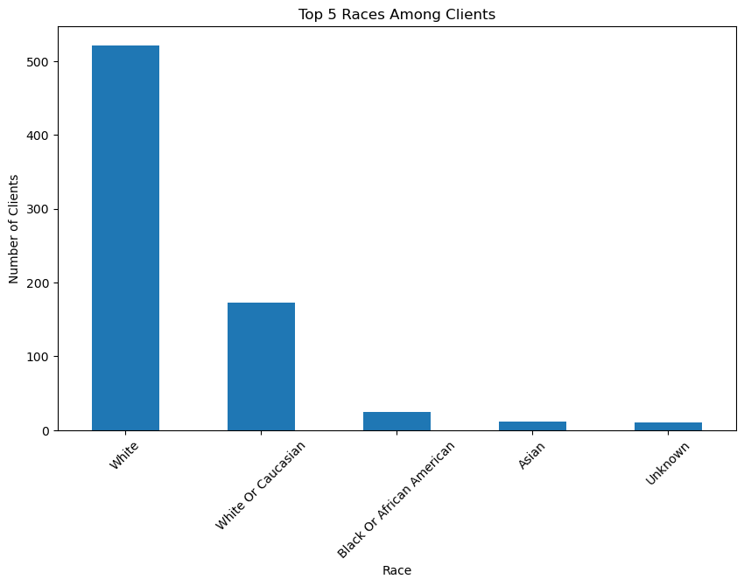
RIT SCB
Race Distribution
Distribution of Racial Data
Data Visualisation
White/Caucasian clients make up 92.7% of the dataset, closely matching findings from a 2021 Pew Research Center survey indicating that 92% of Jewish Americans identify as White.
While the dataset’s racial composition matches national Jewish demographics, the small share of non-White groups limits generalization for those populations.

Slide 15
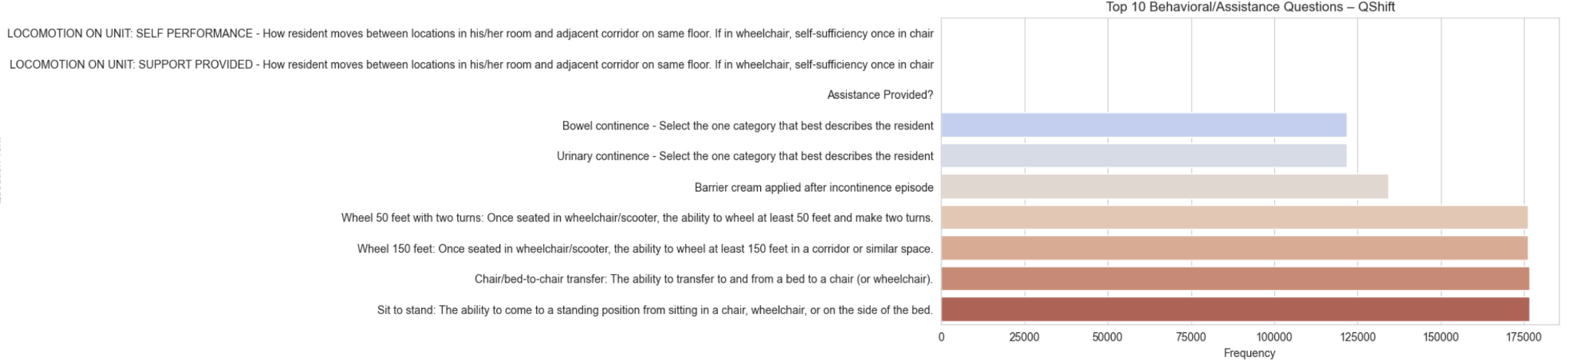
RIT SCB
Race Distribution
Capstone for BANA 2025
Highest frequency entries (>170k each):
Sit to stand – Ability to rise from sitting to standing.
Chair/bed-to-chair transfer – Transfers between bed and chair/wheelchair.
Wheel 150 feet – Mobility in corridors or similar spaces.
Wheel 50 feet with two turns – Short-distance wheelchair/scooter navigation.
Insight: QShift data heavily centers on mobility and transfer capabilities, indicating strong emphasis on tracking resident independence and movement assistance needs.

Slide 16
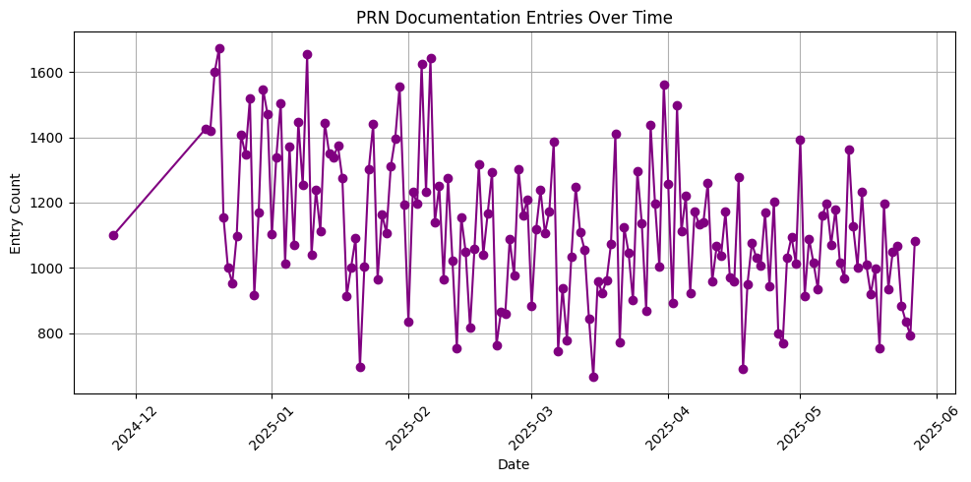
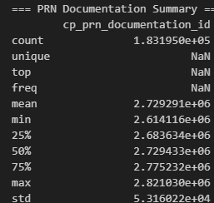
RIT SCB
PRN Documentation
Patterns in PRN Documentation
Capstone for BANA 2025
Over time, we can see that documentation has decreased.
All values have 183195 entries, with some unique and some without
We can identify peaks or patterns in unscheduled care, times when further up / down may require additional care

Slide 17
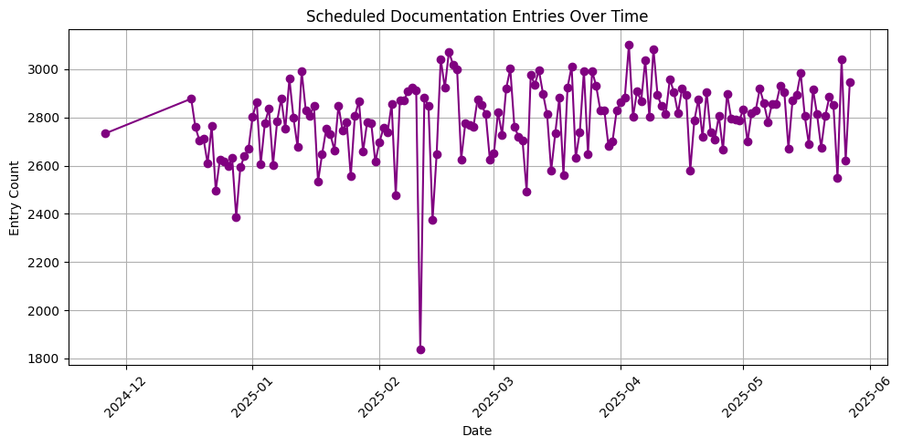
RIT SCB
PRN Documentation
Scheduled Documentation Entries
Capstone for BANA 2025
Represents scheduled documentation entries submitted each day
Consistent pattern indicates routine care and monitoring
Any drops would point towards issues in documentation or compliance

Slide 18
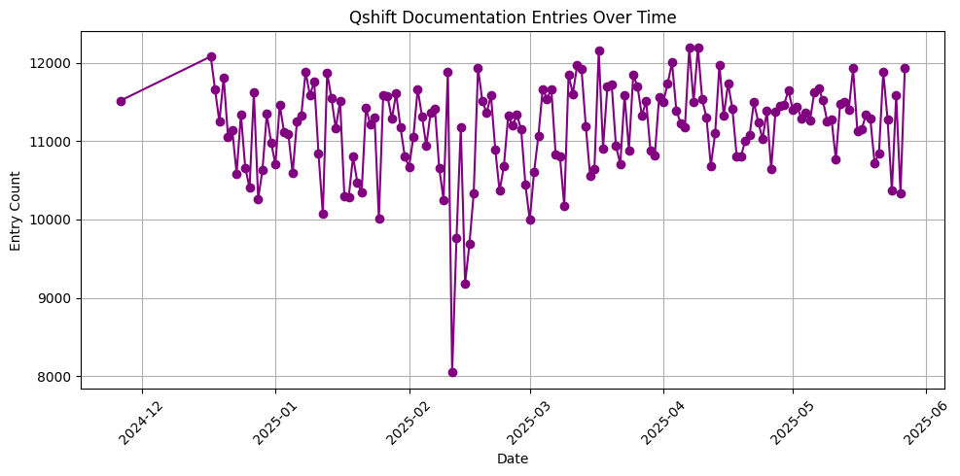
RIT SCB
PRN Documentation
Potential Anomalies?
Capstone for BANA 2025
In our brief assessment, one shift / time appears to be of question
Remainder of shifts and time appear compliant with expected documentation patterns
Next steps should include identifying reasons and why the documentation was lacking at the time
Extenuating circumstances, determine what occurred at the time
PRN Documentation is decreasing over time - is this intentional or a point of concern?

Slide 19
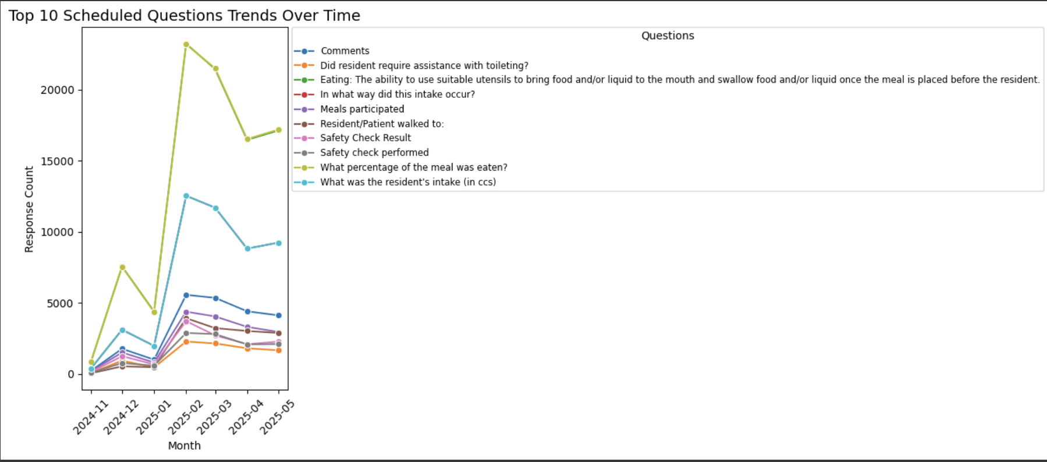
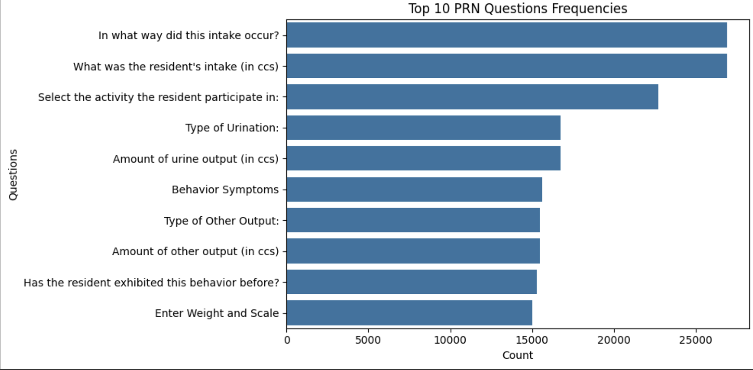
Scheduled & PRN Documentation Insights
Top Care Activity Trends from Scheduled & PRN Data
Scheduled Documentation:
Merged schedules with responses and question text, removing strikeouts to ensure data integrity.
Identified Top 10 scheduled care questions (e.g., toileting assistance, meal participation, safety checks) and visualized trends over time.
Detected seasonal or monthly variations in care activities that could reflect staffing patterns or patient needs.
PRN Documentation:
Analyzed top unscheduled (PRN) care questions (e.g., fluid intake, urination type, behavioral symptoms).
High frequency of hydration- and output-related PRN entries suggests potential focus areas for preventive care.
RIT SCB
CB
Capstone for BANA 2025

Slide 20
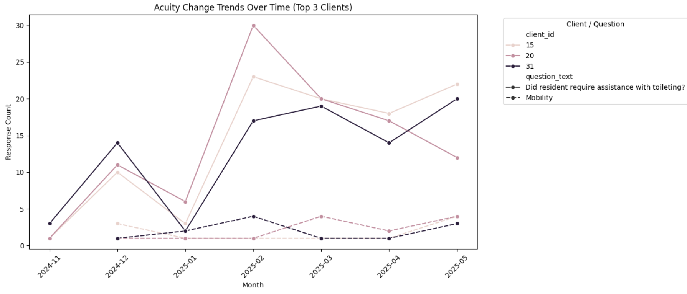
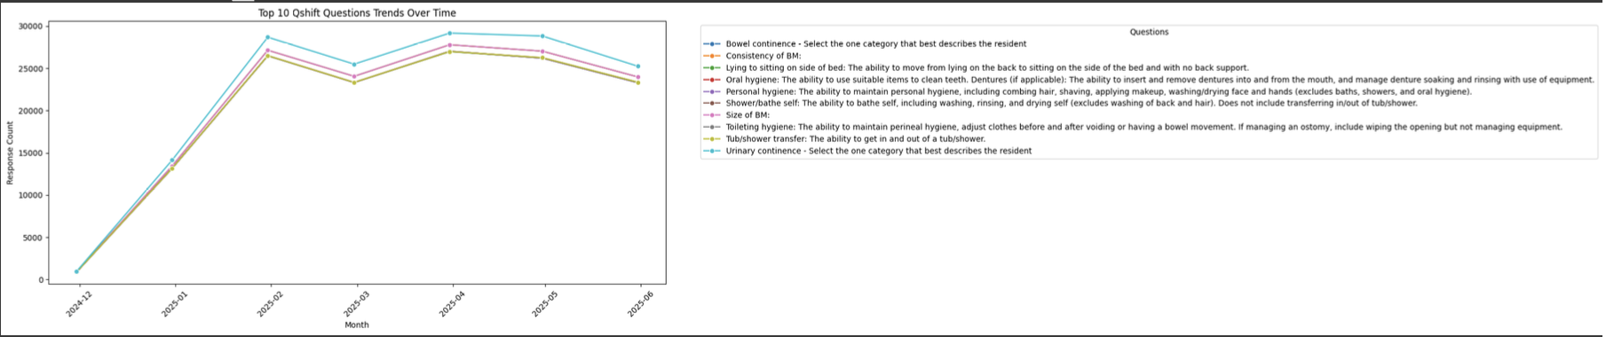
Qshift & Acuity Tracking
Shift-based Care Patterns & Client Acuity Trends
Qshift Documentation:
Processed and merged shift detail with responses to identify Top 10 Qshift care questions (e.g., bowel continence, hygiene, mobility).
Trend analysis revealed consistent patterns in core daily living activities, with peaks during certain months.
Acuity Tracking:
Filtered for activities tied to daily living (toileting, bathing, hygiene, continence, mobility).
Created month-over-month trend lines for the top 3 most active clients, showing periods of increased intervention needs.
These trends can be used to flag potential decline earlier and tailor personalized care plans.
RIT SCB
Capstone for BANA 2025

Slide 21
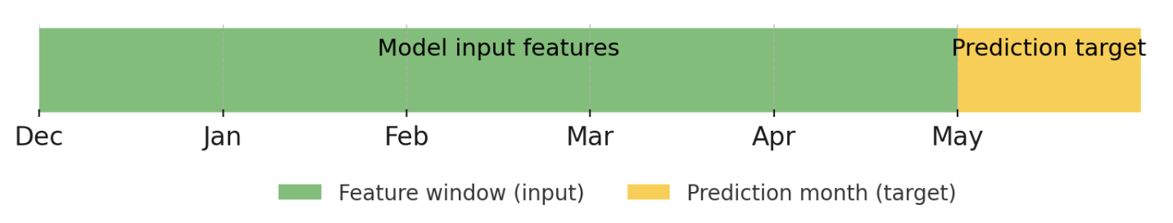
Feature Engineering
Capstone for BANA 2025
Key Steps:
Data filtering – Removed first-month records after admission to avoid bias from initial assessments.
Time window selection – Used features from Dec–Apr to predict outcomes in May.
Activity transformation –
Encoded ADL – Eating levels into ordinal scores (0–5).
Split Fluid Intake into fluid_intake_ml (numeric) and fluid_intake_oral (binary).
Demographics integration – Merged client age, gender, race, marital status, and education level (applied where available).
Note: Specific feature examples will be shown in each model section
*

Slide 22
RIT SCB
Models Used
Model 1
Baseline intervention prediction
Predict monthly intervention count per client for future months using historical care activity data.
(XGBoost Regressor)
Model 2a
Fluid intake change prediction
Predict whether a client’s fluid intake changes significantly month-over-month.
(XGBoost Classifier with SMOTE)
Model 2b
ADL-eating level change prediction
Classify direction of change in ADL–Eating level (decline / stable / improve).
(XGBoost Classifier)
Capstone for BANA 2025

Slide 23
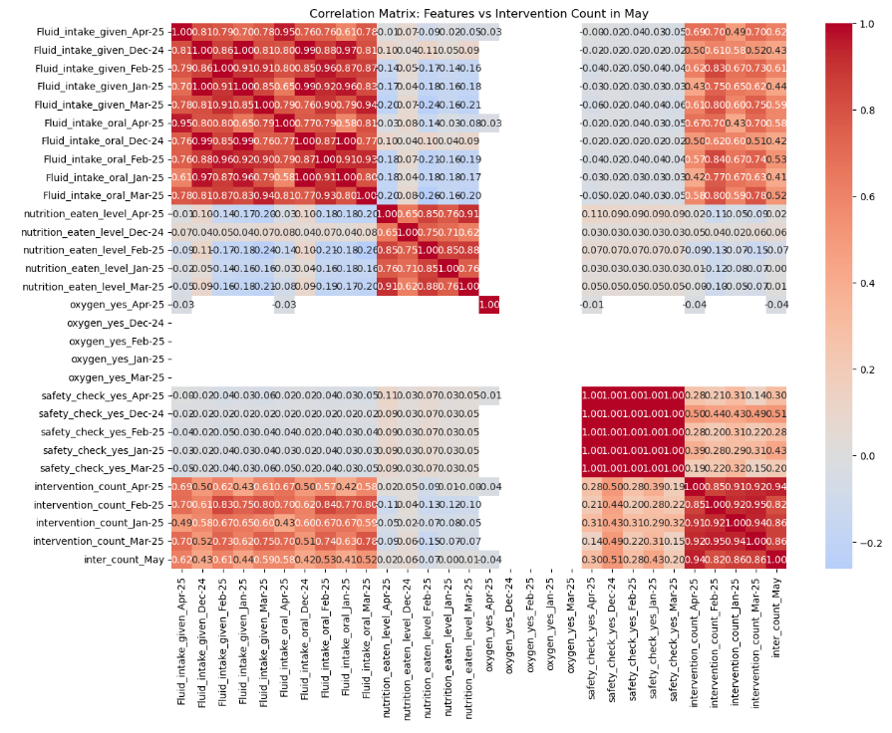
RIT SCB
Model 1 - Baseline intervention prediction （1）
Capstone for BANA 2025
Model type: Regression model predicting intervention count in May 2025 for each client（XGBoost Regressor）
Purpose: Predict monthly interventions per client for upcoming months (e.g., June, July) based on historical patterns, enabling early workload planning and proactive risk alerts.
Features (X): Aggregated monthly features from Dec 2024–Apr 2025, including ADL scores, I&O records, nutrition intake, and other care activity metrics.
Target (y): Total number of interventions in May 2025 per client

Slide 24
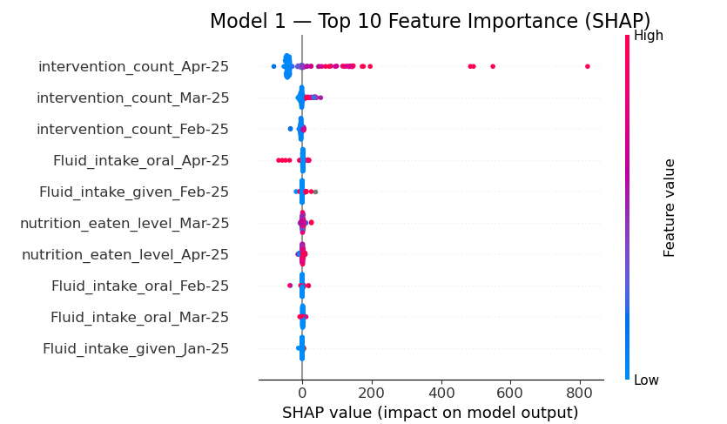

Model 1 - Baseline intervention prediction （2）
Key insight:
Intervention counts in the months immediately before the target period (especially April and March) are the strongest predictors of future needs.
Fluid intake and nutrition patterns also contribute significantly, serving as early warning signals for changes in care demand.
Performance: The model explains 96% of the variance in intervention counts and achieves low prediction errors.
Capstone for BANA 2025

Slide 25
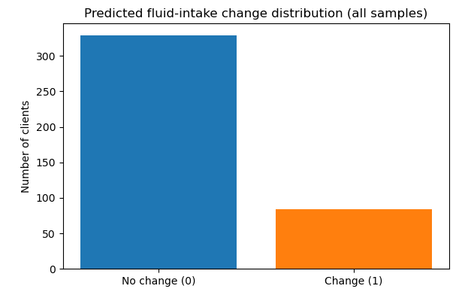
RIT SCB
Model 2a - Fluid intake change prediction （1）
Capstone for BANA 2025
Model type: Binary classification -fluid Intake changes prediction (XGBoost Classifier with SMOTE)
Purpose: Identify clients at risk of fluid intake changes, enabling early hydration interventions and care plan adjustments.
Features(X): Aggregated bi-monthly differences in care metrics from Dec 2024–Apr 2025, including changes in ADL scores, I&O records, nutrition intake, and other activity measures.
Target(y): Binary flag for change in fluid intake from Apr to May 2025 (1 = change, 0 = no change).

Slide 26
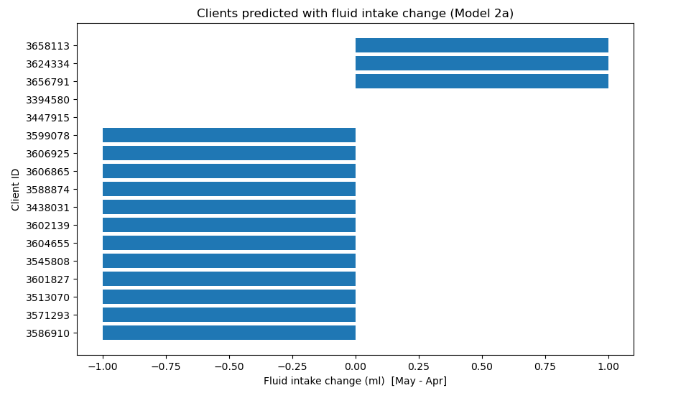
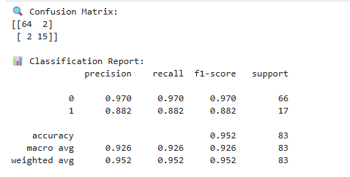
Model 2a - Fluid intake change prediction （2）
Key insight: In testing, the model flagged 17 at-risk clients, 15 with actual changes and 2 false positives, enabling proactive monitoring with low false-alert rates.
Performance: 95.2% accuracy, precision = 0.926, recall = 0.882 for detecting fluid intake changes
Capstone for BANA 2025

Slide 27
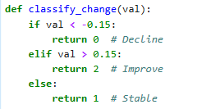
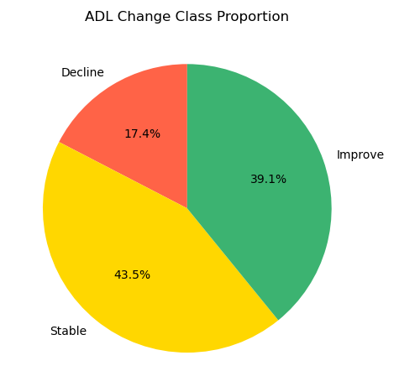
RIT SCB
Model 2b - ADL_eating_level change prediction
(EDA & Label Definition)
Capstone for BANA 2025
Purpose: Use a classifier to predict the direction of change in ADL_eating_level，enabling early detection of significant decline and timely care adjustments, based on changes observed between April and May.
Label definition (y):
0 = Significant decline (ADL_diff_May–Apr < –0.15)
1 = Stable (–0.15 ≤ ADL_diff_May–Apr ≤ 0.15)
2 = Significant improvement (ADL_diff_May–Apr > 0.15)
EDA - Among the 46 clients, 17.4% were classified as experiencing a significant decline, 43.5% as stable, and 39.1% as significantly improved in ADL_eating_level.

Slide 28
RIT SCB
Model 2b - ADL_eating_level change prediction (Features)
Capstone for BANA 2025
Features (X): | Target (y):
Std deviation of monthly nutrition intake differences (Jan–Apr) Change in ADL_eating_level difference from March to April 2025 (Apr ADL diff − Mar ADL diff) Change in Nutrition intake difference from March to April 2025 (Apr Nutrition diff − Mar Nutrition diff) Raw ADL_eating_level in Apr Demographics: Age, Gender Engineered interaction: ADL × Nutrition interaction | 3-class label based on thresholds above 0 = Decline, 1 = Stable, 2 = Improve

Slide 29
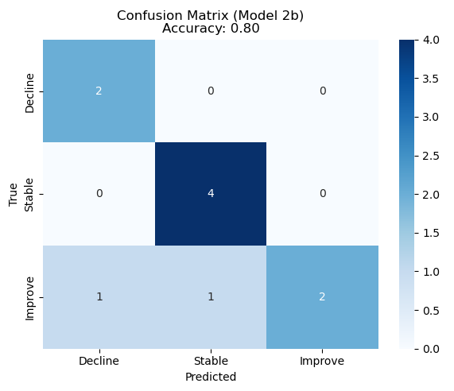
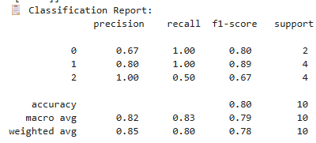
RIT SCB
Model 2b - ADL_eating_level change prediction (Performance)
Capstone for BANA 2025
Model type: XGBoost Classifier for 3-class classification (Decline / Stable / Improve)
Performance: On a small test set (10 samples, total 46), the classifier achieved 80% accuracy, perfectly identifying declines and stable cases but missing half of the improvements, reflecting good risk detection yet limited stability due to sample size.

Slide 30
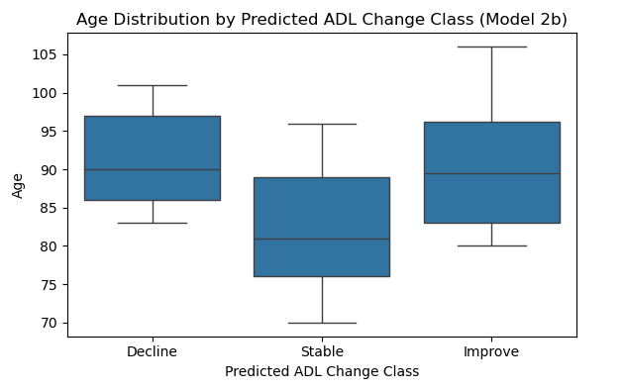
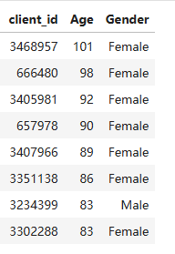
RIT SCB
Model 2b - Age vs. ADL_eating_level change Class
Capstone for BANA 2025
Insight:
Older clients (90+) appear in both decline and improvement groups, indicating greater variability in ADL_eating_level among high-age clients, while younger clients tend to remain stable.
The model flagged 7 clients as at risk of significant decline, with most aged 83+.
Visuals:
Boxplot – Age distribution across predicted change classes (Decline / Stable / Improve)
Table – Predicted decline clients list (client_id, age, gender)

Slide 31
RIT SCB
Takeaways
Capstone for BANA 2025
1
Past intervention counts impact future predictions
The number of interventions in the months prior to the target period is a key predictor of future patient care needs. This enables proactive resource planning and more efficient allocation of workloads.
2
Age related variability in ADL eating ability
Clients in the age range of 83 and above show greater variability in their ADL eating abilities including both decline and improvement. This highlights the need for tailored interventions to prevent further decline and better support clients in this age group.

Slide 32
RIT SCB
Takeaways (continued)
Capstone for BANA 2025
3
Early warning signs for fluid intake changes
Fluid intake and nutrition patterns are key indicators of hydration related risks. Predicting changes in fluid can help implement early support to reduce the risk of dehydration.
4
Targeted support for ADL declines
Clients who are risk for significant declines in ADL eating ability would benefit from timely adjustments to their care plan. Early detection allows for more personalized and proactive support to help clients maintain function.

Slide 33
RIT SCB
Next steps
Capstone for BANA 2025
Integrate chronic condition data - Combine medical history (e.g., dementia, diabetes, heart disease) with current model features to
Improve prediction accuracy
Build a comprehensive risk prediction system
Increase data coverage – Include more months of historical data (e.g., 6–12 months) to boost sample size and model robustness.
Enable real-time monitoring – Deploy models into JSL’s EHR system for automated alerts to care teams.

Slide 34
Thank you!
Capstone for BANA 2025

Slide 35
RIT SCB
Additional Sources
Capstone for BANA 2025
Pew Research Center. (2021). Race, ethnicity, heritage and immigration among U.S. Jews. https://pewrsr.ch/3biPz6c
Jewish Home of Rochester.(2025). About Us, jewishhomeroc.org

